Slide 1
British Airways
Customer ratings analysis and insights
By Ogbuzuru Kelechi
2023-12-09

Slide 2
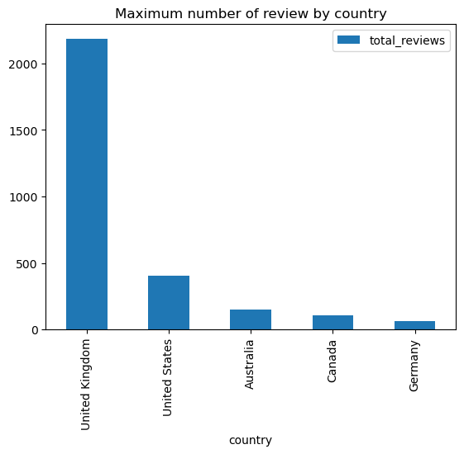
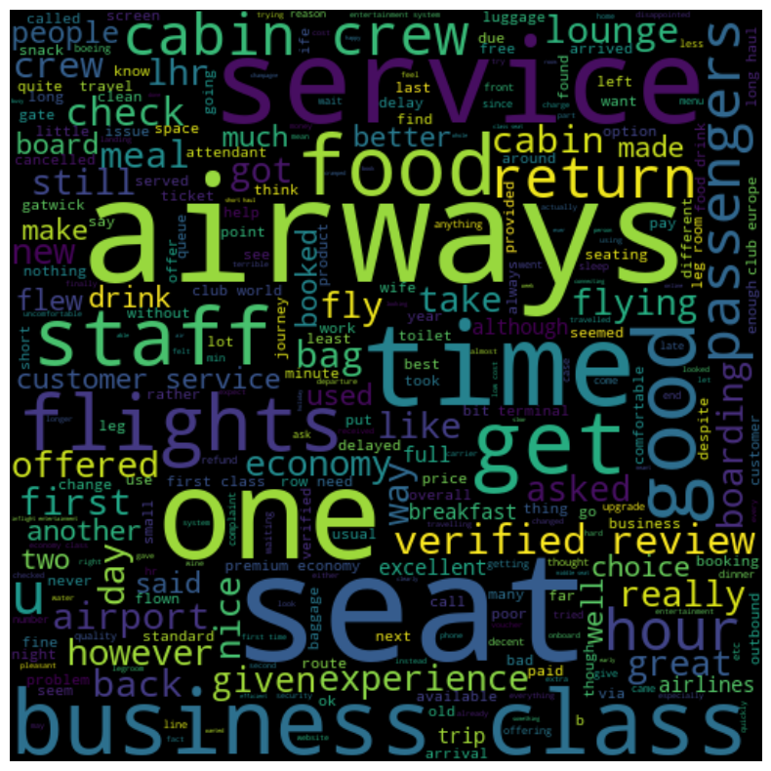
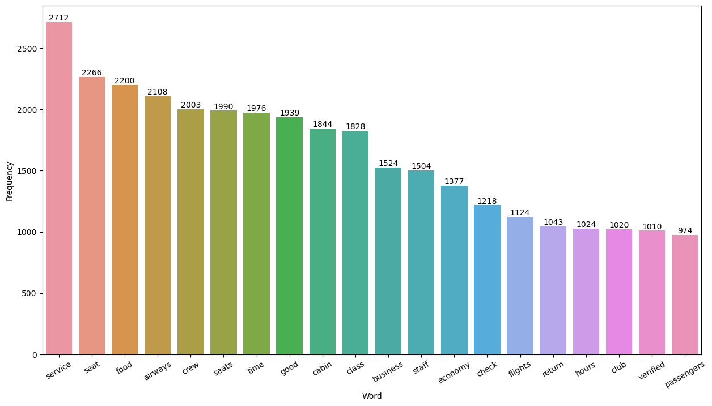
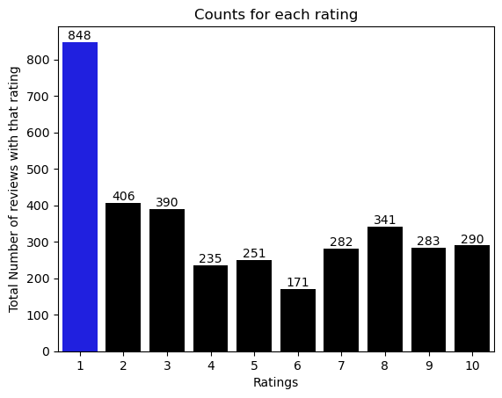
Key metrics
Average Overall Rating
4.63
Reviews from 71 Countries
3497 Total reviews
collected
Identifying customer satisfaction and dissatisfaction across different rating classes:
Ratings 7-10: Praised short-haul business, friendly crew, comfortable legroom, good inflight entertainment, and food.
Ratings 4-6: Experienced issues with small entertainment screens, long passport check queues, and poor business class experience.
Ratings 1-3: Displeasure with congested middle seats and small screens, although they liked the seats and food.
Customers praised cabin crew, seats, and food universally. Business class is popular. Key topics are "service," "seat," and "food," highlighting their importance. To enhance satisfaction, focus on Economy class service, seats, inflight entertainment, and address delays. Improve the Business class experience for better value. Prioritize customer service on refund requests.

Slide 3
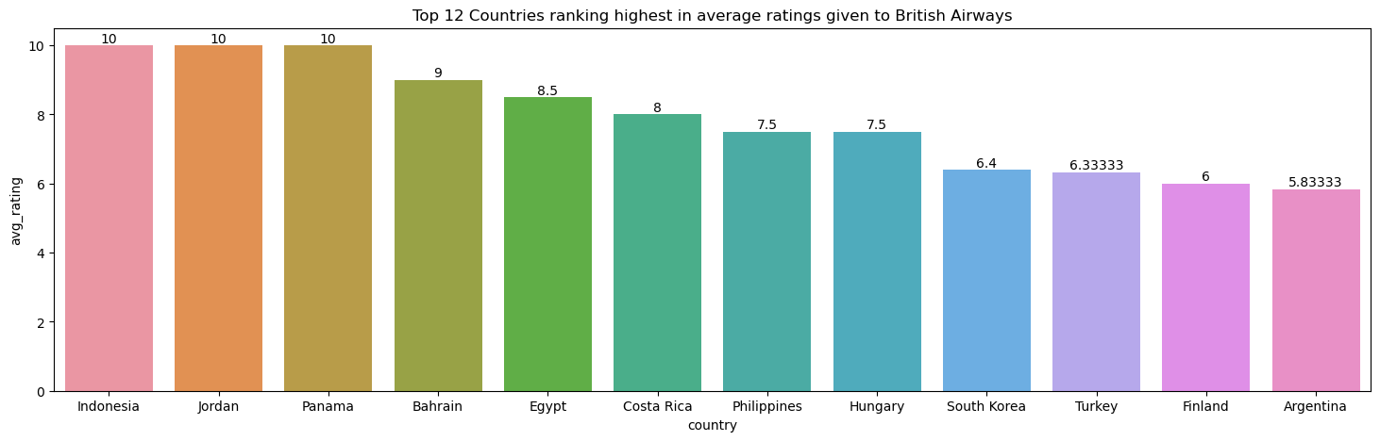
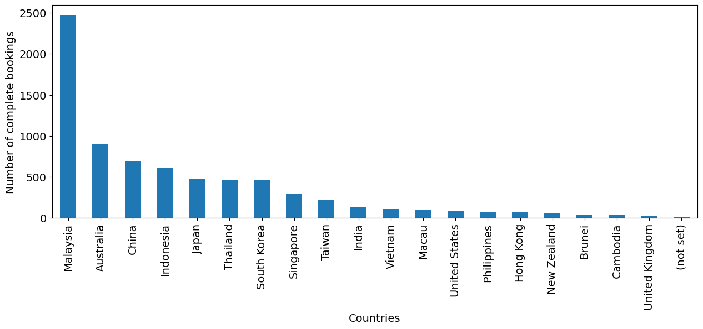
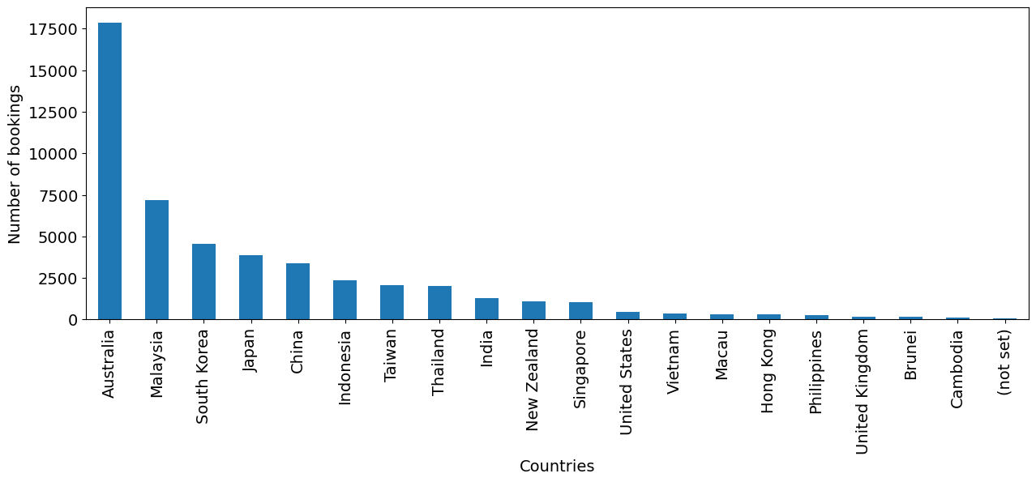
Key metrics
British Airways receives the highest average ratings, starting with Indonesia, followed by Jordan and Panama, all rating the airline 10.
Booking a flight can pose challenges, but Malaysia stands out as the country with the highest completion rate of flight applications, closely followed by Australia, China, and others.
The booking application is most popular in Australia, followed by Malaysia and South Korea, with other countries following suit.
Notes:
Booking a flight can pose challenges, but Malaysia stands out as the country with the highest completion rate of flight applications, closely followed by Australia, China, and others.
British Airways receives the highest average ratings, starting with Indonesia, followed by Jordan and Panama, all rating the airline 10.
The booking application is most popular in Australia, followed by Malaysia and South Korea, with other countries following suit.

